Slide 1


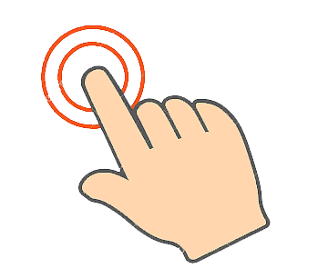
VIRTUAL MOUSE
Panimalar Engineering College
DEPARTMENT OF COMPUTER SCIENCE AND ENGINEERING
CS8811 PROJECT WORK
REVIEW NO:1
(Artificial Intelligence)
Guide_name : Dr. L. Jaba Sheela
Deepika P (2018PECCS121)
Janani N (2018PECCS142)
Janet Jessica R (2018PECCS143)

Slide 2
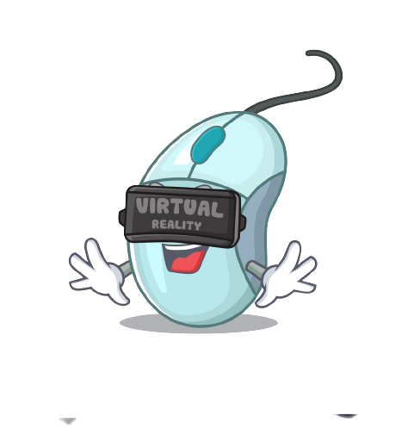

Abstract
Virtual Mouse aims to eliminate the needs of having a physical mouse while able to interact with the computer system through webcam by using various image processing techniques.
It promotes an approach for the Human Computer Interaction (HCI) where it utilizes a camera and computer vision technology to control various mouse events and is capable of performing every task that the physical computer mouse can.

Slide 3
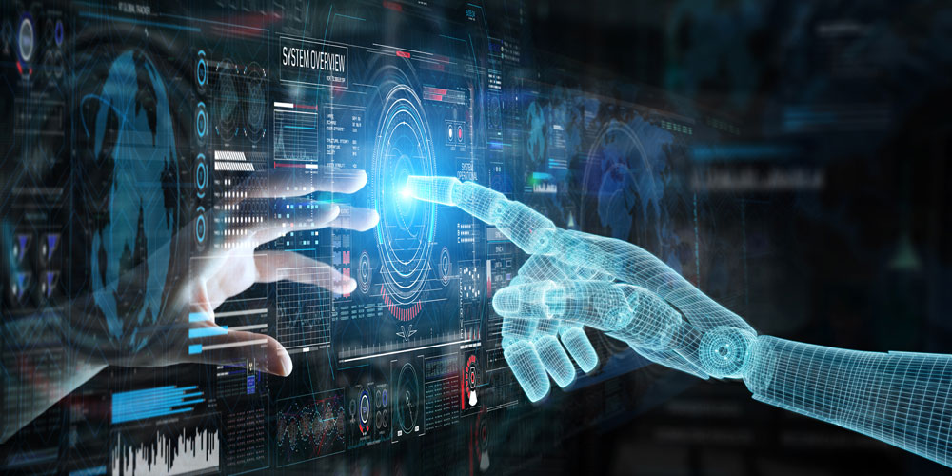
INTRODUCTION
It is believed that gestures are the easiest way of interaction with anyone. So then why not apply it to the machines that we are using.
In this work, we are demonstrating, real- gesture.
It focuses on extracting the features over the human hands and then matching their features to recognize the movement of the hand.

Slide 4

LITERATURE SURVEY

Slide 5

PAPER 1
Upasana, V Monisha Joseph, Kanchana V.p , YEAR : May,2017 “Virtual Mouse with RGB Colored Tapes”, Institute of Electrical and Electronis Engineering(IEEE), 0973-4562-6647-6
METHODOLOGY: Coded tapes
PROS : identification was accurate
CONS : Not flexible all the time

Slide 6
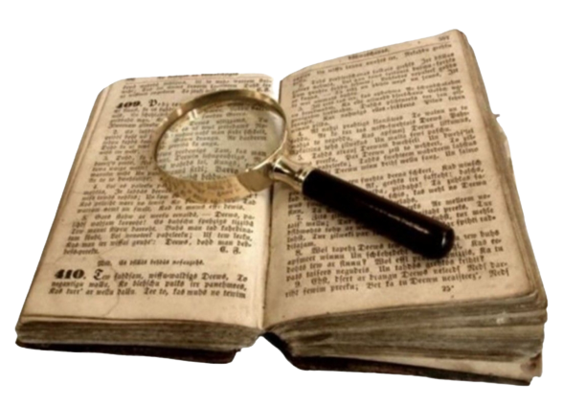
PAPER 2
Itsuo Kumazawa, Toshihiro Kai, Yoshikazu Onuki, and Shunsuke Ono, YEAR : December,2017 “Measurement of 3D-Velocity by High-Frame-Rate Optical Mouse Sensors to Extrapolate 3D Position Captured”, Institute of Electrical and Electronis Engineering(IEEE), 978-1-5090-6647-6/17
METHODOLOGY: External mouse sensors
PROS : Increased speed, high accuracy
CONS : Additional Hardwares

Slide 7

PAPER 3
Changhyun jeon, oh-jin kwon, dongil shin, and dongkyoo shin, YEAR: February 2018, “Hand-Mouse Interface Using Virtual Monitor Concept for Natural Interaction”, Institute of Electrical and Electronis Engineering(IEEE), DOI10.1109/ACCESS.2017.2768405
METHODOLOGY: Whole skeleton
PROS : Removing physical mouse
CONS : Recognition of whole body

Slide 8
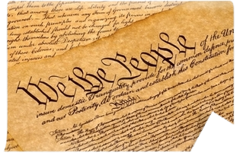
PAPER 4
Sherin Mohammed Sali Shajideen Preetha V H, YEAR: March 2018, “Virtual Mouse for Human Computer Interaction”, Institute of Electrical and Electronis Engineering(IEEE), ISBN : 978-1-5386-5873-4
METHODOLOGY: Tracking 3D models using dual cameras
PROS : Identifies 3D gestures in hand
CONS : Additional hardware

Slide 9

PAPER 5
Swati Tiwari, Siddhi Parkar, Shruti Gharat, Kinjal Patel, Prof. Khalil Pinjari , YEAR: October 2018, “Virtual mouse using sixth sense technology” Institute of Electrical and Electronis Engineering(IEEE), 978-1-5386-5873-4
METHODOLOGY: Frame extraction
PROS : Increased clarity
CONS : Required high level of storage

Slide 10
PAPER 6
Kollipara Sai Varun, I. Puneeth, Dr. T. Prem Jacob, YEAR: January 2019“Virtual Mouse Implementation using Open CV”, Institute of Electrical and Electronis Engineering(IEEE), 978-1-5386-5873-4
METHODOLOGY : Real-time computer vision, Deep Learning
PROS : Able to identify fingers more accurate
CONS : Only basic functions

Slide 11

PAPER 7
Tiwari, Siddhi Parkar, Shruti Gharat, Kinjal Patel, Prof. Khalil Pinjari, YEAR: May 2019 “Design and Development of Hand Gesture Based Virtual Mouse”, Institute of Electrical and Electronis Engineering(IEEE) , 978-1-5386-5873-4
METHODOLOGY: Histogram analysis of skin pixels
PROS : Started to identify digits in fingers
CONS : complexity of skintones

Slide 12
PAPER 8
Vantukala VishnuTeja Reddy1 , Thumma Dhyanchand2 , Galla Vamsi Krishna3 , Satish Maheshwaram4 YEAR: November 2019, “Virtual Mouse Control Using hand gloves ” Institute of Electrical and Electronis Engineering(IEEE), 978-1-5386-5873-19
METHODOLOGY : Robotic arm
PROS : All gesture were identified
CONS : Adding external physical object

Slide 13

PAPER 9
Sherin Mohammed Sali Shajideen; VH Preetha, YEAR :2019 “Hand Gestures - Virtual Mouse for Human Computer Interaction” Institute of Electrical and Electronis Engineering(IEEE), 778-1-5386-5873-4
METHODOLOGY: Accurate values in finger pointing with 3-D space
PROS : Started detecting complete hand with palms and fingers
CONS : Complex

Slide 14

PAPER 10
Banda Aneela , Narlanka Vasuki, Rebelli Sai Sahana, Charupalli Sunil Kumar, YEAR 2021, ”Implementing a Real Time Virtual Mouse System and Fingertip Detection based on Artificial Intelligence”, Institute of Electrical and Electronis Engineering(IEEE), 778-1-5386-5873-4
METHODOLOGY: Detecting hand landmarks
PROS : More accurate
CONS: Does not work in browser, Zooming in and out

Slide 15
Problem statement
The following describes the general problems that the current mouse affairs face today:
Physical mouse is subjected to mechanical wear and tear.
Physical mouse requires special hardware and surface to operate.
All wired and wireless mouses have their own lifespan.
Physical mouse is not easily adaptable to different environments and its’ performance varies on the environment.
Mouse has limited functions even in present operational environment.

Slide 16
FEASIBILITY STUDY
Economic Feasibility:
Here we have done our project estimation by COCOMO model based on total Lines of Code(LOC) which required to develop our project .
Total Lines of code (LOC)=850
Hand Gesture Recognition: (LOC=540)
Estimation of development effort = a(KLOC)b PM
= 2.4(0.54)1.05 PM
= 1.26 PM
Estimation of Development time = c(effort)d
= 2.5(1.26)0.38
= 2.72 M
MODULE | CATEGORY
Hand Gesture Recognition | Organic
Voice Assistant | Organic
Virtual Mouse | Semi-Detached

Slide 17
Voice Assistant:
Lines of Code(LOC)=250
Estimation of Effort = 2.4(0.25)1.05
=0.5 PM
Estimation of Development Time = 2.5(0.5)0.38
= 1.9 M
VIRTUAL MOUSE:
Lines of Code(LOC)= 56
Estimation of Effort= 3.0(0.056)1.2
= 0.09 PM
Estimation of Development Time= 2.3(0.09)0.35
= 1.07 M
Total Effort = 1.26+ 0.5+ 0.09 = 1.85 PM Total Development Time= 2.72+ 1.9+ 1.07 = 5.6 Months

Slide 18
Technical FEASIBILITY:
Language used- Python
Our system is implemented using python programming language ,since Python has inbuilt modules like cv2, Media pipe and Autopy which are all required for tracking and controlling the movements of hand.
System used- Pycharm
We have used Pycharm platform for running our task since it is an integrated development environment used in computer programming specifically for the Python programming language.

Slide 19
Social Feasibility:
As the name virtual mouse denotes this project is to eliminate the needs of having a physical mouse while able to interact with the computer system through webcam by using various image processing techniques. Overall feasibility study of the project reveals that the goals of the proposed system are achievable.

Slide 20
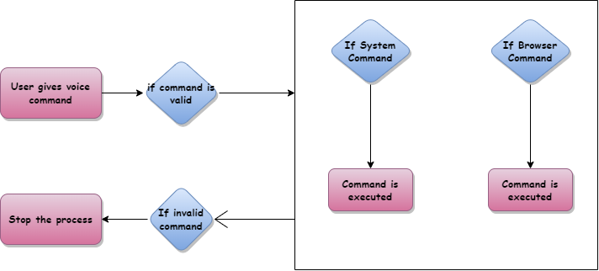
SYSTEM ARCHITECTURE
PROTON

Slide 21
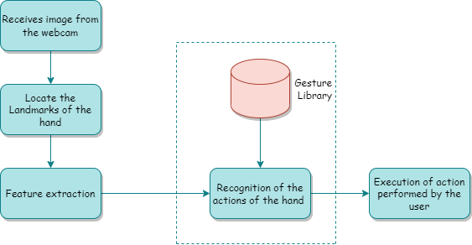
SYSTEM ARCHITECTURE
VIRTUAL MOUSE

Slide 22

SYSTEM ARCHITECTURE

